Slide 1
Divide and Conquer Approach

Slide 2
Divide and Conquer Approach
An approach to design an algorithm
Breaks down a problem into smaller parts/sub problems
Solve sub problems and combine their answers to form solution
Sub problems can be solved using parallel computing (e.g using Hadoop and Spark)

Slide 3
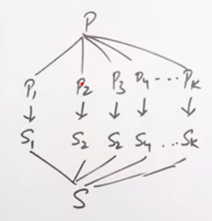

Slide 4
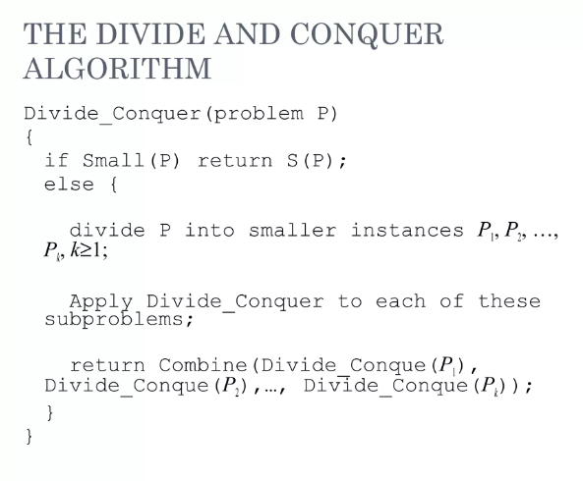

Slide 5
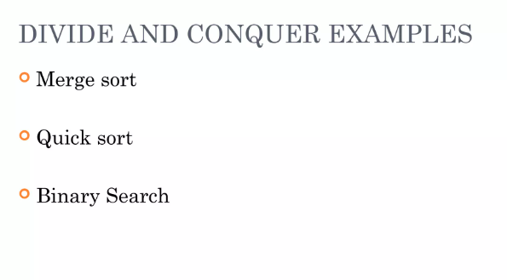

Slide 6
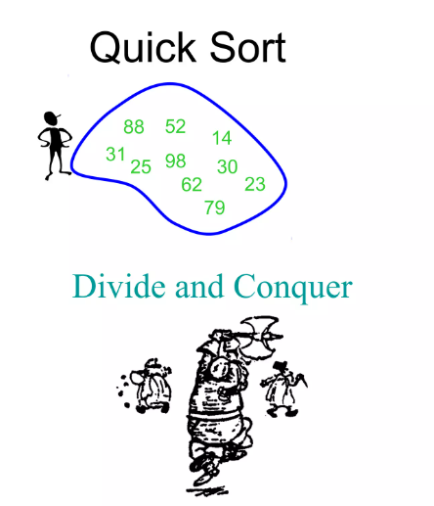

Slide 7
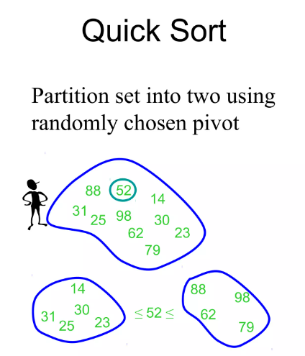

Slide 8
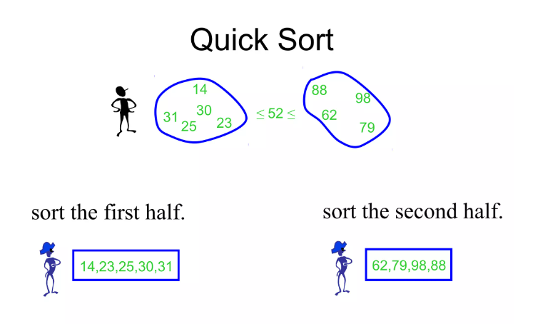

Slide 9
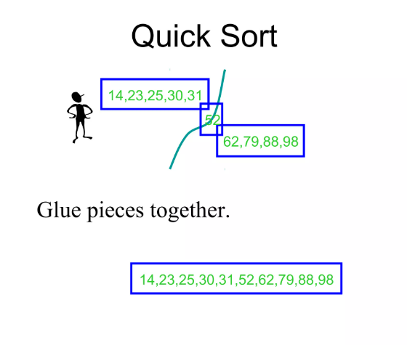

Slide 10
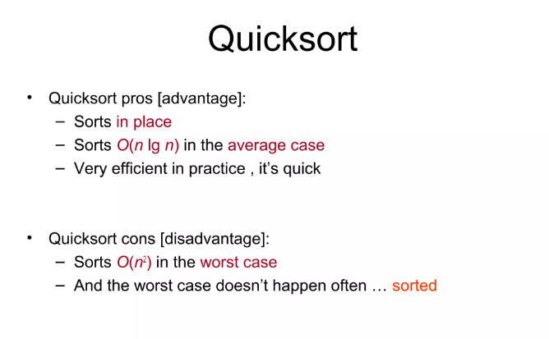

Slide 11
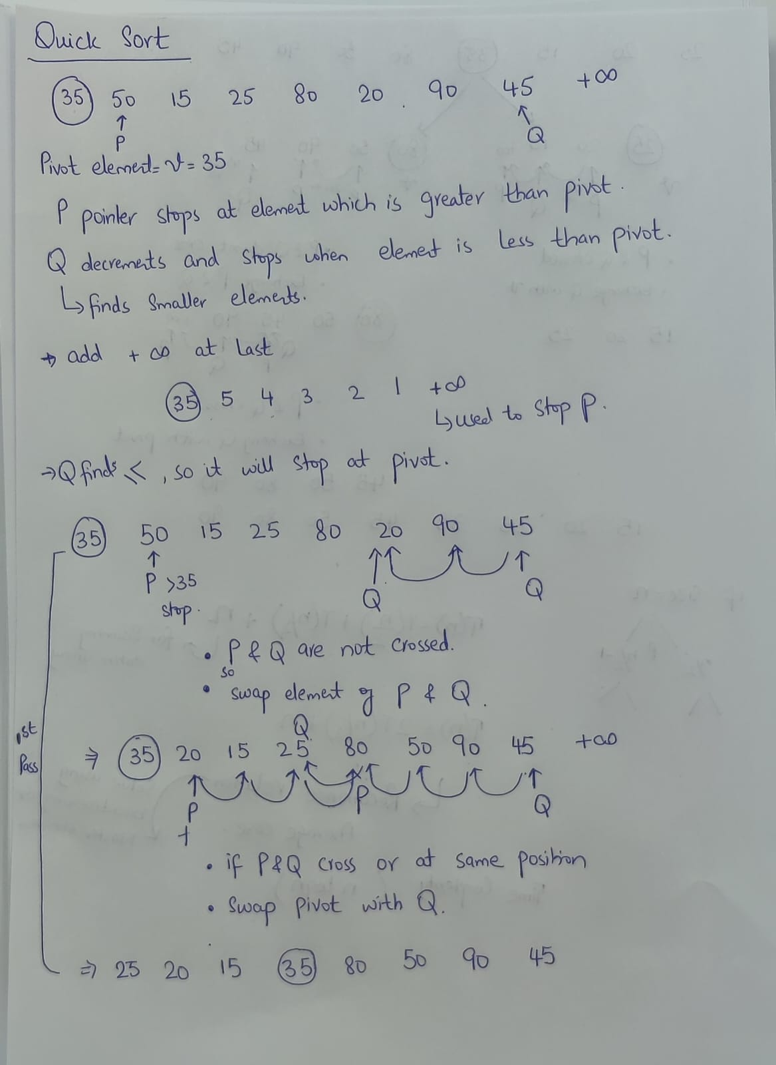

Slide 12
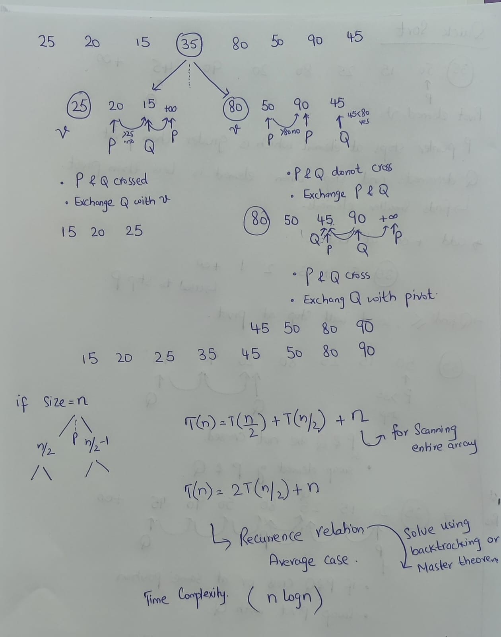

Slide 13
Balanced Partitioning
If pivot element reaches at middle after first pass
Best case of quick sort
Time Complexity : nlogn

Slide 14
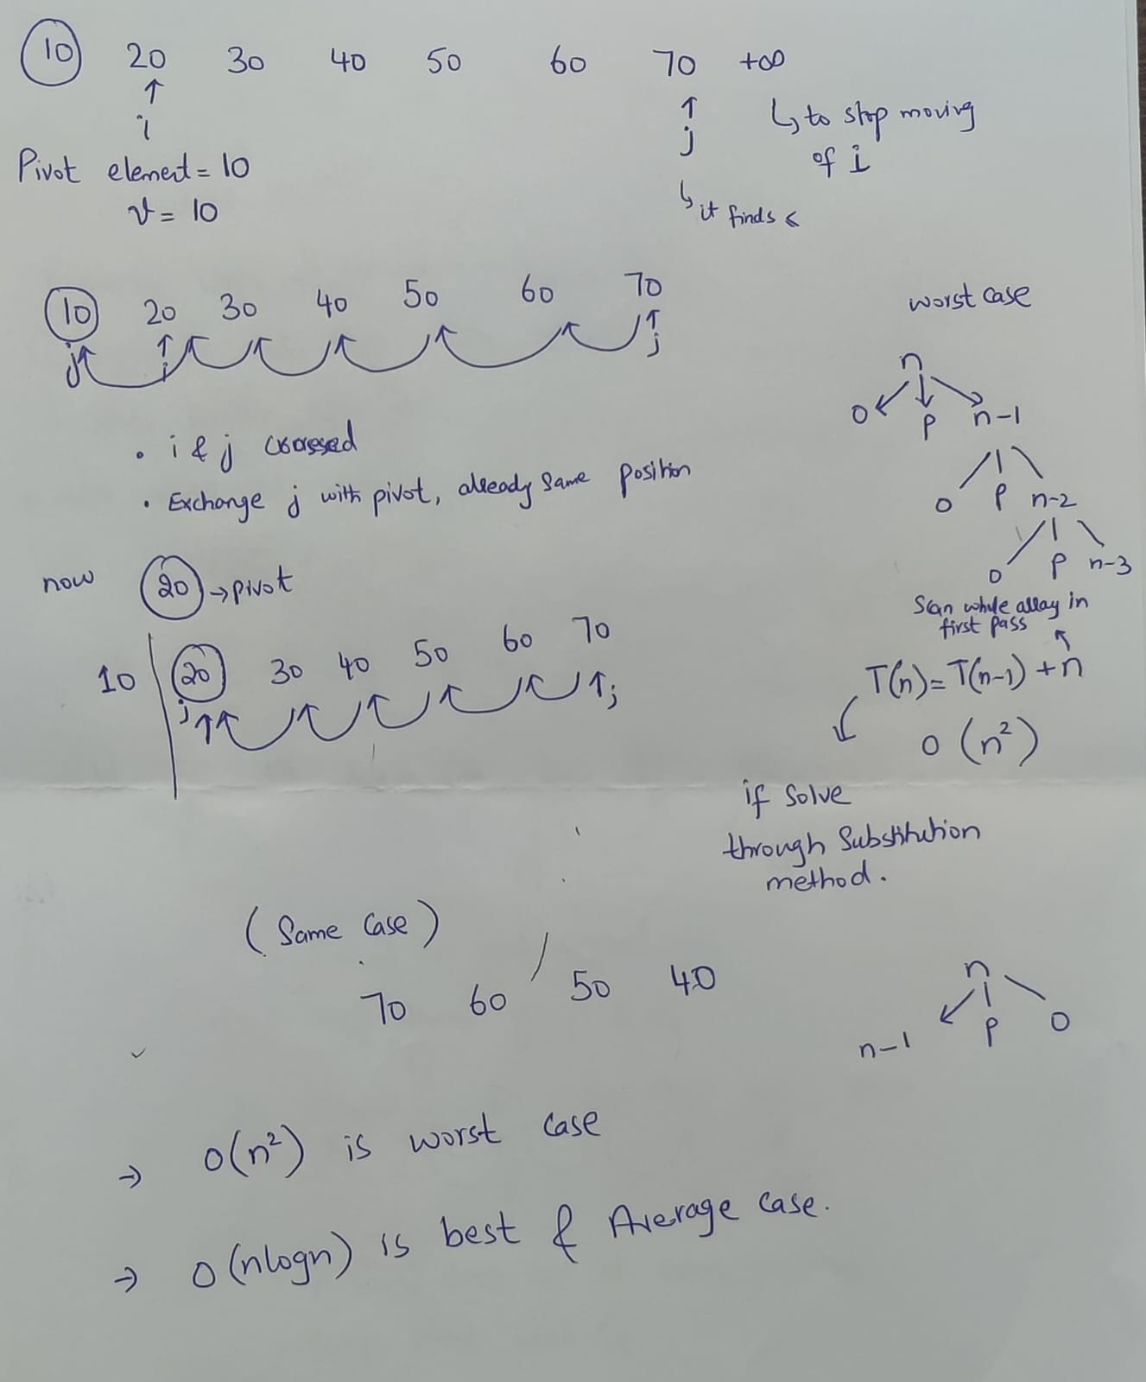

Slide 15
Merge Sort

Slide 16
